Slide 1
XTDir Pages for EasySocial
Adding Pages to EasySocial Community Network
Presentation based on Joomla 3, EasySocial v1.0.7, SobiPro 1.1 and XTDir 5.0.6
2013-11-13

Slide 2
XTDir Pages for EasySocial
In this presentation, we are going to show how you can add Pages, based on SobiPro, to your Joomla! / EasySocial community network.
About EasySocial, It's everything you need to start a social network in Joomla. EasySocial is best for enterprises and intranets.
About SobiPro, SobiPro is a powerful directory component for Joomla!
http://www.extly.com/xtdir-adding-pages-to-easysocial-community-network.html

Slide 3
About Pages
In a social network, Pages build a closer relationship between the users and their audience.
Pages provide tools for business, brands or organizations.

Slide 4
Prerequisites
Prerequisites
XTDir for EasySocial 5.0.6, or superior
EasySocial 1.0.7, or superior
SobiPro 1.1, or superior (recommended)
SobiPro 1.0.8 is supported
Joomla 2.5 / 3.1 / 3.2, or superior
MySQL 5.5, or superior (recommended)
PHP 5.3, or superior
About EasySocial v1.0.6, or below, please copy this default.php into administrator/components/com_easysocial/themes/default/forms, to enable Apps configuration custom fields.

Slide 5
XTDir Pages for EasySocial
XTDir is a single component, with a set of modules and plugins, to add the most frequently requested EasySocial and SobiPro features. All configuration and management tasks are performed in a single administrative center.
My SobiPro Entries, an EasySocial app and a Joomla! module, to show SobiPro entries associated with an EasySocial user profile.
User Profile for SobiPro, a SobiPro read-only field to show EasySocial user profile in associated SobiPro entries.
SobiPro Activity Stream for EasySocial, a SobiPro App to push activities to the community wall stream (including reviews).
Extended Search Modules, modules to master the art of catalog search. Support for cookie form saving.
Categories of SobiPro Module, a module with 6-Layouts to navigate your catalog categories
Search in Categories, Search in Selected Section Modules, and Search Plugin(+) Plus, to fill all search possibilities.
CategoriesFilterApp, a SobiPro App to show a chained categories control and support empty keyword search in SobiPro.
Product Page: http://www.extly.com/easysocial-extensions.html
Support: http://support.extly.com Community Forum Support: http://www.extly.com/forum/index.html

Slide 6
XTDir Pages for EasySocial
This presentation is focused in the social network and directory customization:
My SobiPro Entries, an EasySocial app and a Joomla! module, to show SobiPro entries associated with an EasySocial user profile.
User Profile for SobiPro, a SobiPro read-only field to show EasySocial user profile in associated SobiPro entries.
SobiPro Activity Stream for EasySocial, a SobiPro App to push activities to the community wall stream (including reviews).
The objective is to implement:
Community notifications of directory activity,
Pages access from User Profiles, and
User Profile access from directory Pages
To configure the rest of XTDir’s apps, modules, and plugins:http://www.extly.com/guides-faq/75-extensions-for-sobipro-documentation/xtdir-for-sobipro.htmlhttp://www.extly.com/xtdir-building-an-advertising-catalog-for-joomla.html

Slide 7
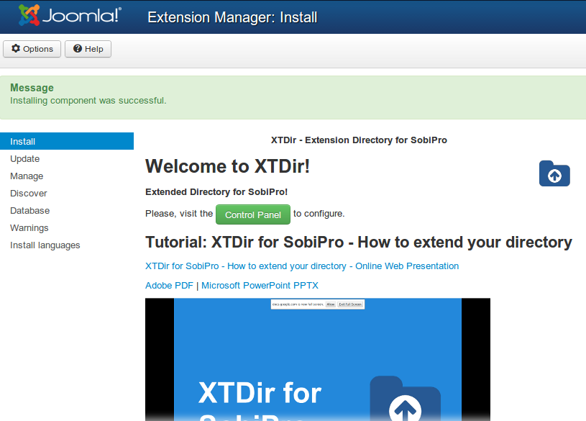
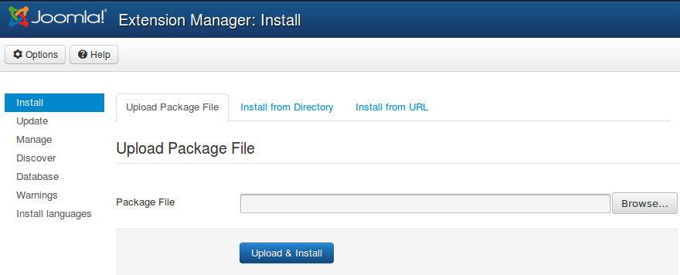
Installation
Download and install XTDir for EasySocial

Slide 8
Updates
1. XTDir updates are installed in the same way
2. Remember to also update SobiPro Apps with the Update button.
"Update" buttons in XTDir / Business Pages

Slide 9
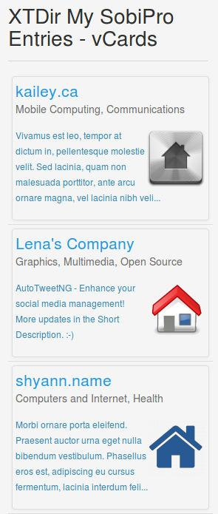
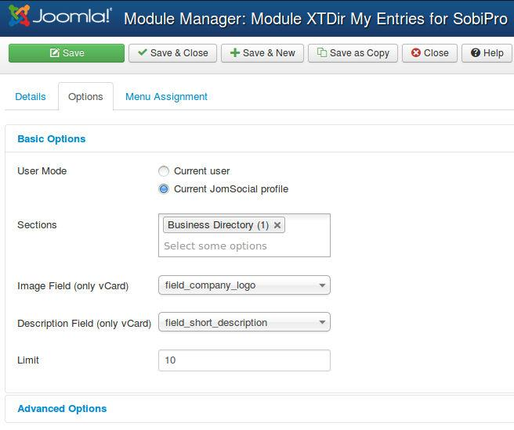
My SobiPro Entries
My SobiPro Entries module, it’s installed in the list of modules.
It can be configured in the Module Manager to a position with several control parameters.
vcard layout

Slide 10
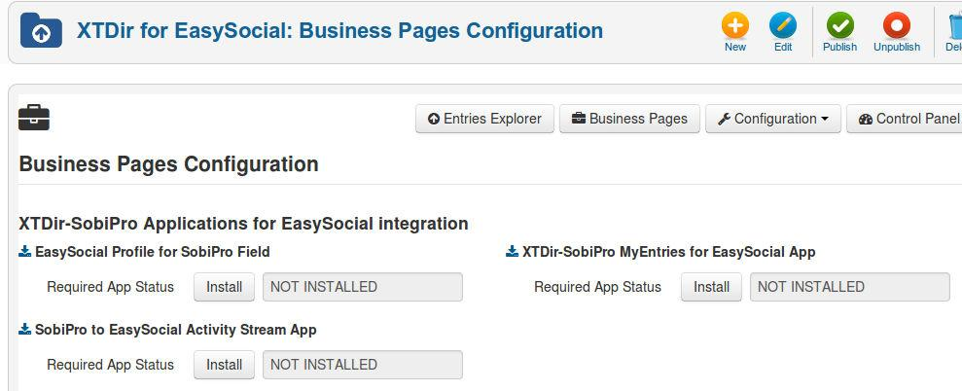
SobiPro & EasySocial Apps
All native SobiPro or EasySocial Apps can be installed right from XTDir / Business Pages.

Slide 11
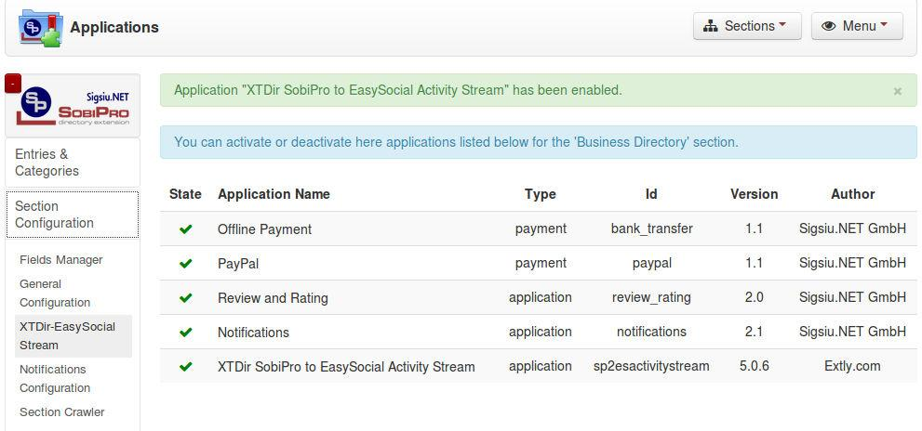
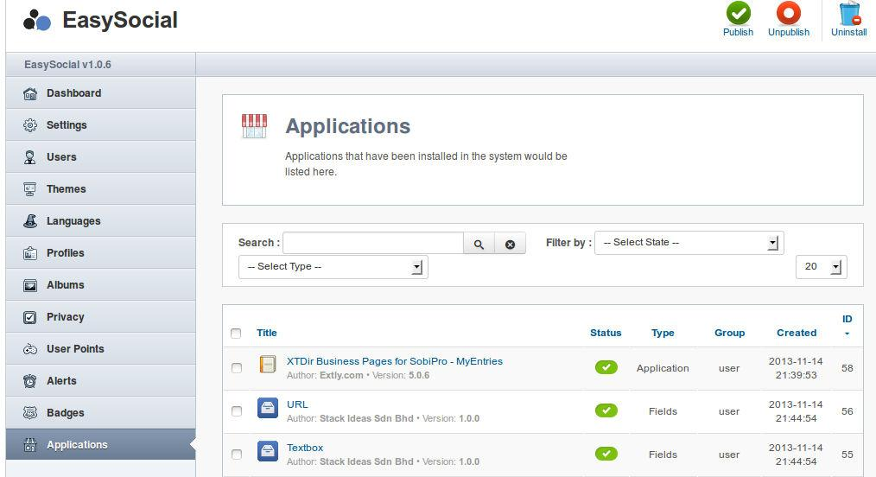
SobiPro & EasySocial Apps
Remember to enable SobiPro Apps at section level, and check EasySocial configuration.

Slide 12
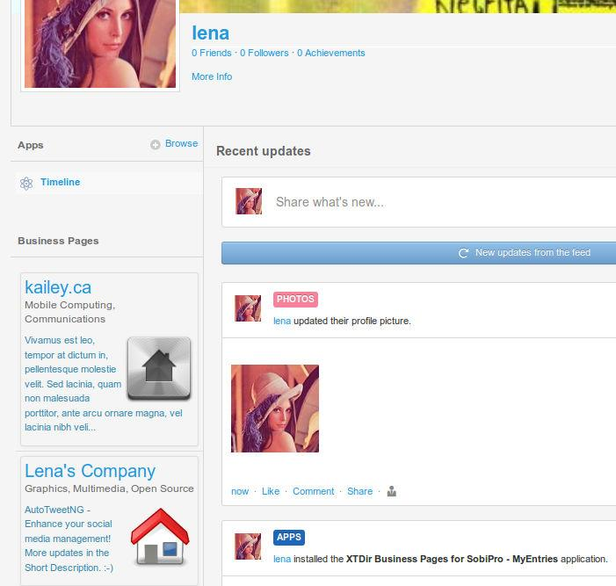
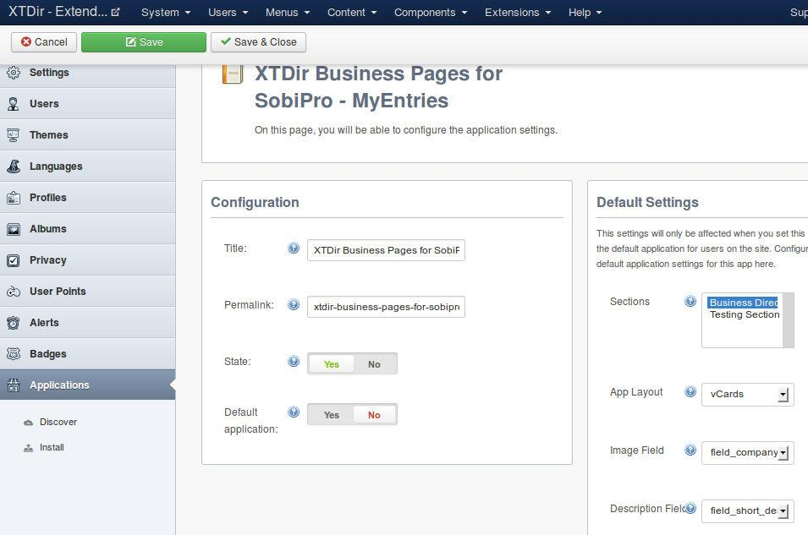
My SobiPro Entries
My SobiPro Entries app, it’s installed in EasySocial’s list of apps.
It can be enabled in the App Manager with several control parameters.
vcard layout

Slide 13
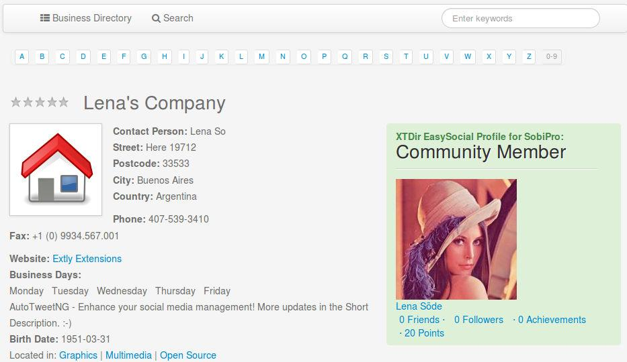
User Profile for SobiPro
User Profile for SobiPro is a SobiPro read-only field to show EasySocial user profile in associated SobiPro entries.
It can be visually customized according your template.
It’s managed as a SobiPro field.

Slide 14
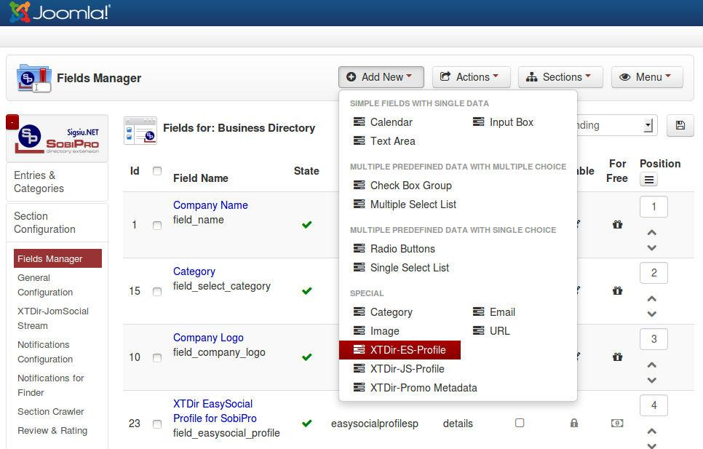
User Profile for SobiPro
To configure the User Profile for SobiPro, the field must be added to the entry structure.

Slide 15
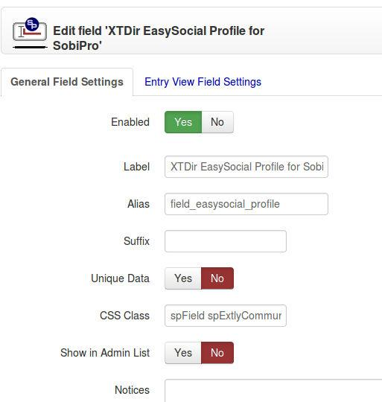
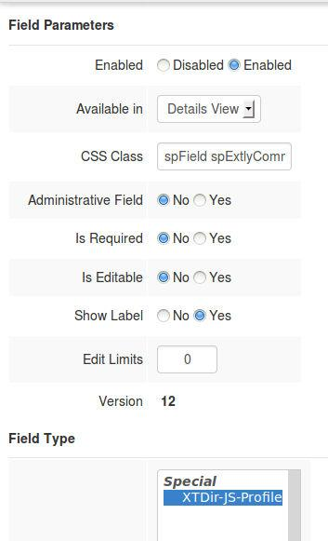
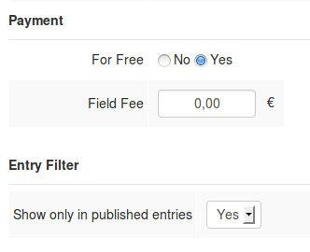
User Profile for SobiPro

Slide 16
User Profile for SobiPro
User Profile for SobiPro is shown by default with a simple style.
Sample CSS styling template customization:
.spExtlyCommunity {
float: right;
width: 300px; background-color: #DFF0D8;
border-color: #D6E9C6;
color: #468847; border-radius: 4px 4px 4px 4px;
padding: 8px 35px 8px 14px;
text-shadow: 0 1px 0 rgba(255, 255, 255, 0.5);
}
.spExtlyCommunity .groups, .spExtlyCommunity .photos, .spExtlyCommunity .videos, .spExtlyCommunity .events, .field_business_days li {
display: inline-block;
margin-right: 8px;
}

Slide 17
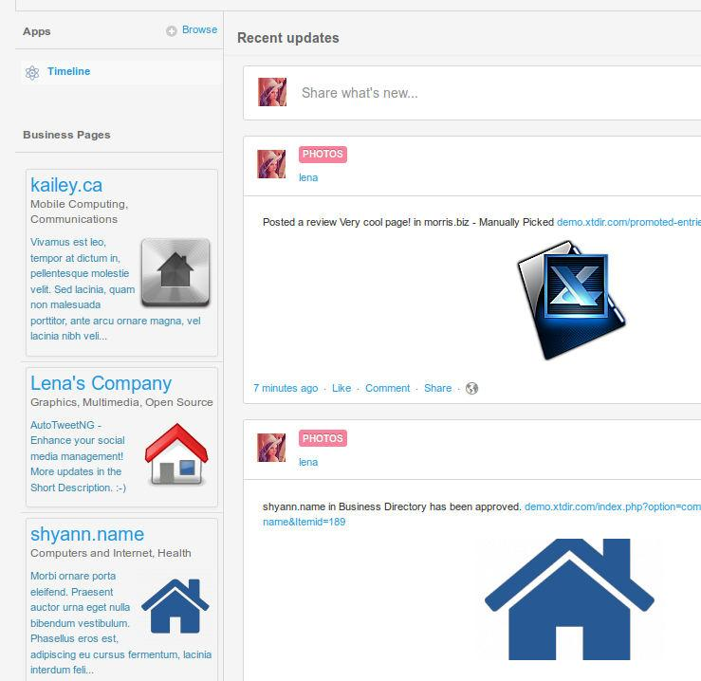
SP Activity Stream for EasySocial
SobiPro Activity Stream for EasySocial is a native SobiPro App to publish directory activities to the community wall stream (including reviews).
In this way, all community members can check what’s going on in Pages.

Slide 18
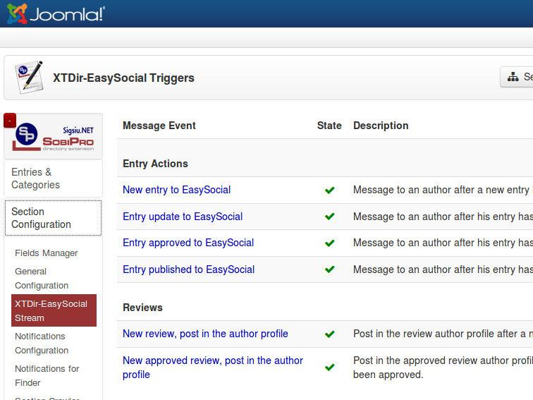
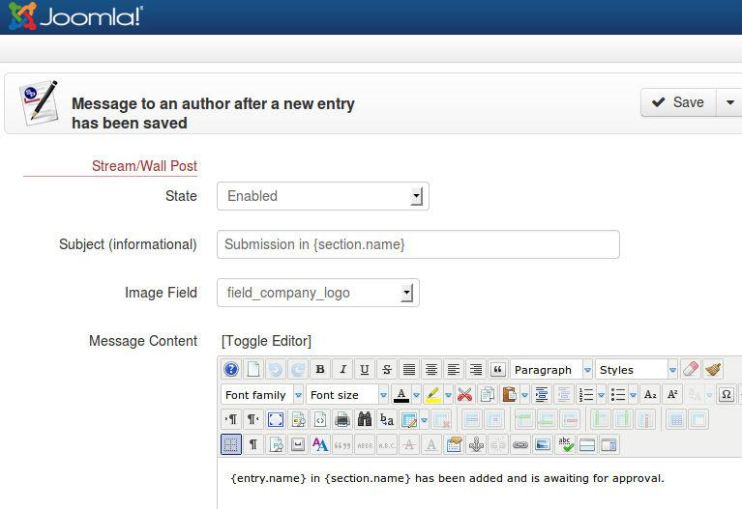
SP Activity Stream for EasySocial
SobiPro Activity Stream for EasySocial, enable and configure the App at section level.

Slide 19
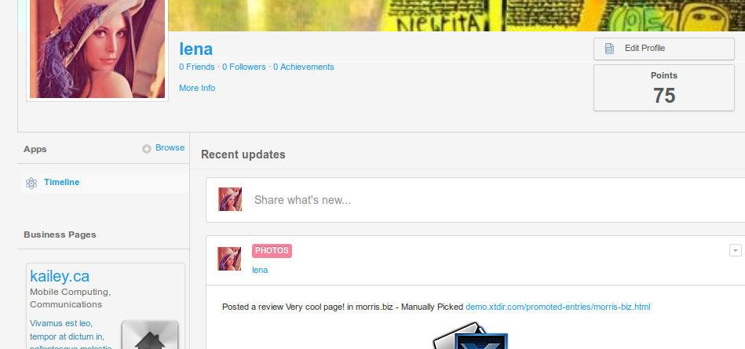
SP Activity Stream for EasySocial
With the built-in points system in EasySocial, your site can utilize the points system by generating points for a user when they perform specific actions. It is a great way to generate interaction from users since they will be able to achieve points. XTDir is integrated and raising specific events.
More info: http://docs.stackideas.com/developers/points/points

Slide 20
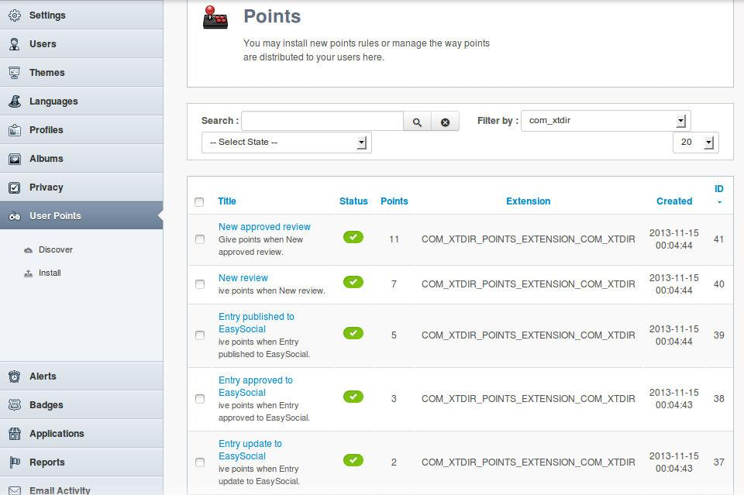
SP Activity Stream for EasySocial
To configure the User Points, you must copy the rules file into a directory, and re-scan for new rules, or upload the rules definition in EasySocial:
Copy from easysocial_rule.points from media/com_xtdir/rules to /administrator/components/com_xtdir.
Re-scan in EasySocial / User Points, or just upload the file.
More info: http://docs.stackideas.com/developers/points/rule_file

Slide 21
Conclusion
In this presentation we have shown how to install and configure:
My SobiPro Entries, an EasySocial app and a Joomla! module, to show SobiPro entries associated with an EasySocial user profile.
User Profile for SobiPro, a SobiPro read-only field to show EasySocial user profile in associated SobiPro entries.
SobiPro Activity Stream for EasySocial, a SobiPro App to push activities to the community wall stream (including reviews).
In this way, navigational aids to provide Pages for EasySocial has been implemented. Users can be notified of directory activity, Pages can be accessed from a User Profile, and User Profiles can be accessed from directory Pages.

Slide 22
One last word
We love your feedback, it's our way to improve.
This presentation was created with your help.
Please post a rating and a review at the #JED
It really helps ;-)
More info: XTDir - How to extend your directoryhttp://www.extly.com/guides-faq/75-extensions-for-sobipro-documentation/xtdir-for-sobipro.html
Support: http://support.extly.com Community Forum Support: http://www.extly.com/forum/index.html
Twitter @extly
Facebook facebook.com/extly

